Slide 1
NMGR P33A NEW MODEL JUSTIFICATION
Side glass subassembly equipment manufacturing for P33A
Kadykov, Vladimir

Slide 2
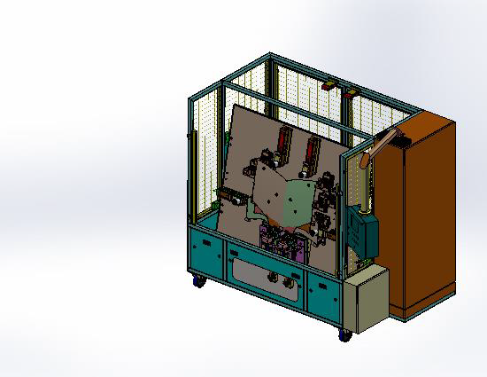
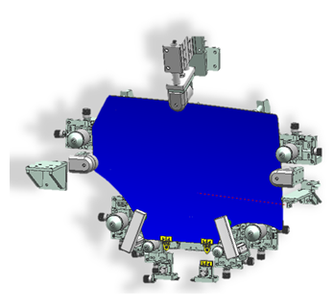
Project summary
Background
Due to P33A side glass shape changes, it is necessary to prepare new equipment for door glass assembly with holders
Scope of work
Manufacture and installation of the 2 door glass subassembly machines and 4 checking fixture
Project timing
Contract Jun`21
Manufacturing Nov`21
Installation Dec`21
Sign-off Apr`22
Budget
WBS-P-P33A2P/PT/PTC1/002
M Rub
10,785 MRub
1,721MRub
9,064 MRub
Glass SubAssy eqpt budget
Saving
This PR
amount

Slide 3
Thank you

